Slide 1
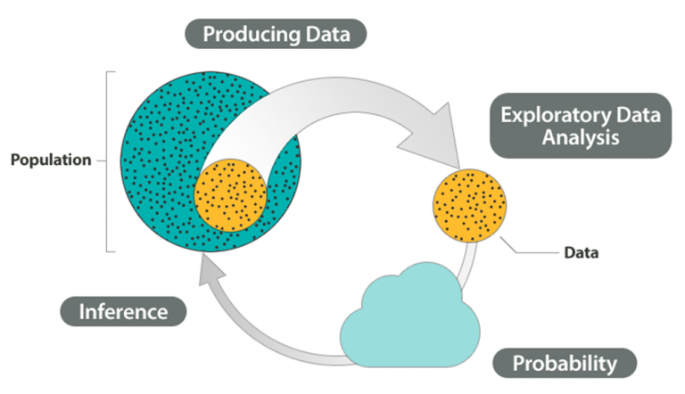
Confidence Intervals
Point Estimation
Interval Estimation
Estimation
Testing Hypothesis
Dr. Abolfazl Saghafi
Assistant Professor of Statistics & Data Science
Data Science Program Director
Chapter 6
Notes:
Everything we learned in the previous chapters, we put it in use in the following two chapters to make inferences, to make data driven decisions, and you see why what we learned so far is SO important!

Slide 2
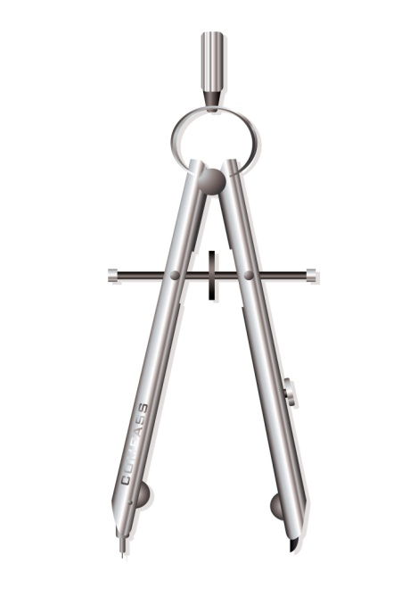
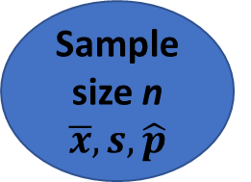
Inferential Statistics
Population
size N
parameters
μ, σ, p
Sample size n
$$\overline{x}, s, \hat{p}$$
Inferential Statistics includes methods of using information from a sample to make inferences (Estimation/Testing) about a population parameter.
Point estimation involves the use of sample data to calculate a single value (known as a statistic) which serves as a "best guess" of an unknown population parameter μ, σ, or p.
Interval estimation is the use of sample data to calculate an interval of probable values, say (L, U), of an unknown population parameter. This interval is called confidence interval.
Usually we use a point estimation as the center and build the CI around it based on a degree of confidence.
Notes:
The random phenomenon (X) we’re investigating has a pattern of occurrence which is represented by a distribution. This distribution has some parameters which show the behavior of X. Whether it’s mean, standard deviation, proportion, etc., we would like to estimate these parameters.

Slide 3
Examples
Ex1: Assume you want to estimate the time it takes for you to go to sleep.
Parameter:
Point estimate:
Interval estimate:
mean time to sleep
5 minutes
2 to 15 minutes
Assume you want to estimate the time it takes for you to get home after work.
So you record the commute time for a number of times as follows
18 32 22 35 25 22 21
What parameter is under estimation and what could be an estimate of this parameter?
Ex2: How long patients sleep by 1 dose of an anesthetic.
Parameter: mean sleep time
Point estimate: 8 hours
Interval estimate: ( 5 , ∞ )
Ex3: How many patients visit the pharmacy with a flu per day on late October.
Parameter: mean # of patients
Point estimate: 10
Interval estimate: ( 8 , 12 )
Parameter:
Point estimate:
Interval estimate:
mean commute time (μ)
25 minutes
15 to 35 minutes
Notes:
You have gone home from work a couple of times before, so have a clear idea of an estimated time, say 25 minutes.
But it is highly unlikely for you to be home exactly in 25 minutes. Instead, you can say with some degree of confidence that you will be home sometime between 15 to 35 minutes.

Slide 4
Examples
Ex1: The proportion of people in the US who will vote for A
Point estimate: 45%
Interval estimate: (42% , 48%)
Suppose you want to estimate the ratio of USP students that will vote on the next election. What is your population and parameter of interest? What is the workflow?
Ex2: What percentage of guests attending a big ceremony are left-handed?
Point estimate: 7%
Interval estimate: (6% , 8%)
Decide on samples size, perform sampling, gather data, organize data, analyze data, make estimation for the parameter.
Ex3: The percentage of students who pass the course with A+
Point estimate: 25%
Interval estimate: (23% , 27%)
Parameter:
Point estimate:
Interval estimate:
proportion who vote (p)
73%
70% to 76%

Slide 5




Why Estimate?
Estimation help us to
* Know what to expect for better Decision Making
* Compare alternative choices
* Compare results in different time intervals
* Make a profit by forecasting
* For curiosity
Why study a sample instead of the whole population?
* Study the whole population is time consuming
* It is expensive to study the whole population
* It is impossible to study the whole population
* The study is destructive and can’t do it for the population

Slide 6

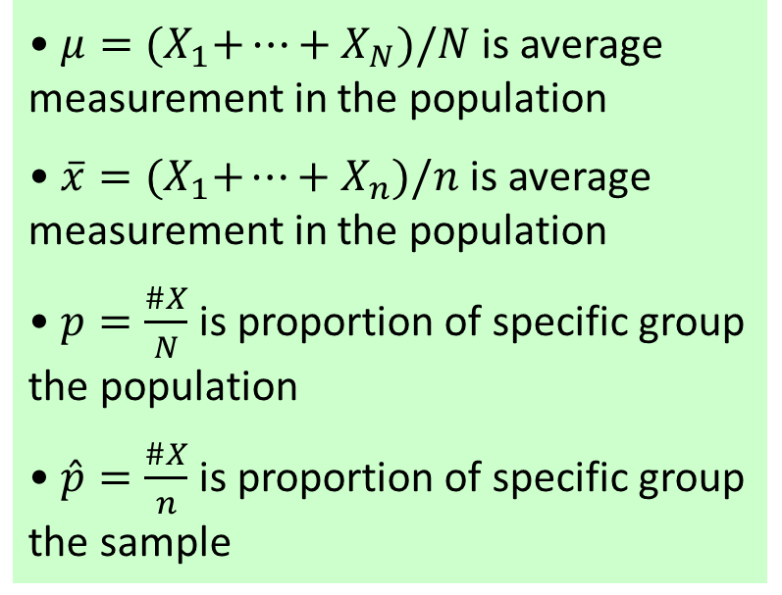
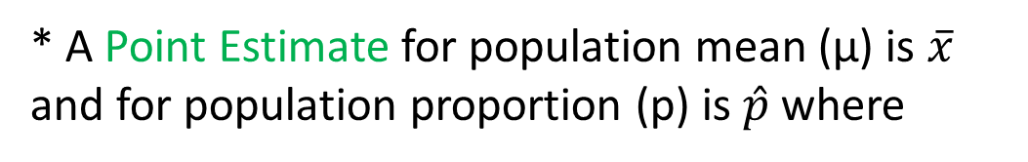
Interval Estimation
• $μ={(X}_{1}+…+X_{N})/N$ is average measurement in the population
• $\overline{x}={(X}_{1}+…+X_{n})/n$ is average measurement in the population
• $p=\frac{\#X}{N}$ is proportion of specific group the population
• $\hat{p}=\frac{\#X}{n}$ is proportion of specific group the sample
A Confidence Interval (CI) consists of three parts
* A point estimate
* A margin of error
* A confidence level
* A Point Estimate for population mean (μ) is $\overline{x}$ and for population proportion (p) is $\hat{p}$ where
* The Margin of Error when added to the point estimate creates the Upper confidence level, and when subtracted from the point estimate creates the Lower CL.
( L , U )
Point
Estimate
Lower CL
Point
Estimate
Point
Estimate
ME
Upper CL
ME
Notes:
By adding ME to a point estimate, we create upper confidence limit
By subtracting ME from a point estimate, we have lower confidence limit

Slide 7
Interval Estimation
As a rule of thumb, in a 90% Confidence Interval, 9 out of 10 such intervals generated using 10 independent samples contain the true population parameter.
A Confidence Interval (CI) consists of three parts
* A point estimate
* A margin of error
* A confidence level
* Confidence Level shows how often the estimated interval contains the true parameter. A (1- α)% confidence level means
P(L < μ < U) = 1 – α
BEFORE building the interval. Furthermore, α is called significance level.

Slide 8
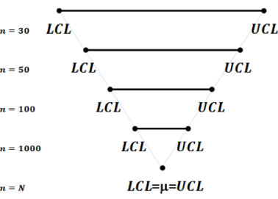
Level of Confidence / Sample Size
Increasing the Confidence Level results in WIDER intervals BUT wider is not necessary better as wider intervals are less informative.
For fixed values of confidence level, as we increase the sample size n, the length of the interval decreases.
This is a GOOD BUT more sample means more time and increased expenses.

Slide 9
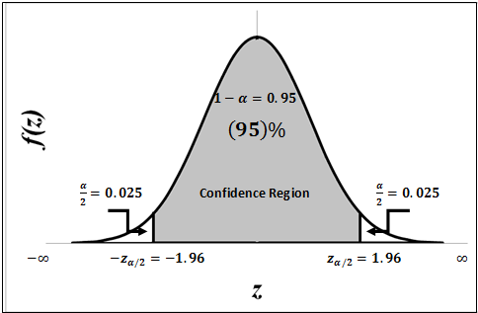
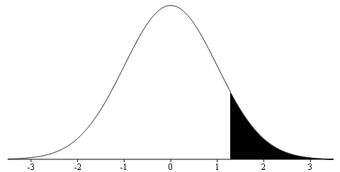
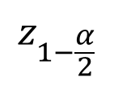



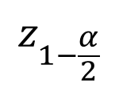
Common Confidence levels
Common Confidence levels are 90%, 95%, and 99% which implies α/2 is 0.05, 0.025 and 0.005 respectively.
The Z value for these intervals is (do NOT add to formula sheet, learn to compute it)
$$z_{1−\frac{α}{2}}$$
$$z_{0.95}=1.645$$
$$z_{0.975}=1.96$$
Use a 95% IF confidence level was not given
$$z_{0.995}=2.58$$
$$z_{1−\frac{α}{2}}$$
Notes:
The reason is given in the top left side

Slide 10
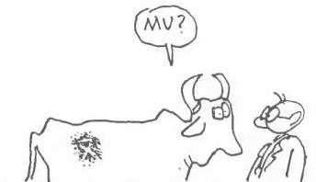

Confidence Intervals for Population Mean
μ
Z Confidence Intervals

Slide 11
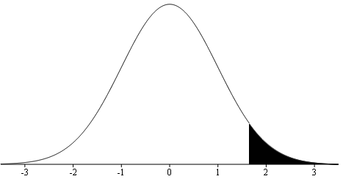
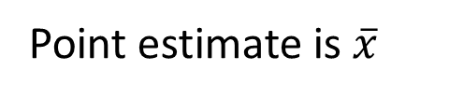
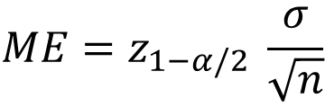
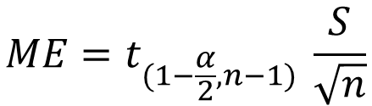
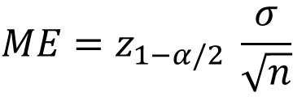

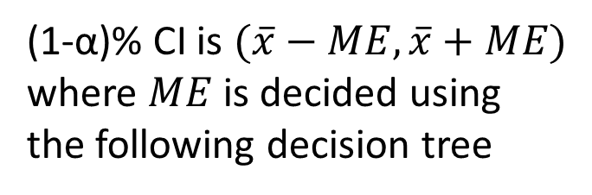
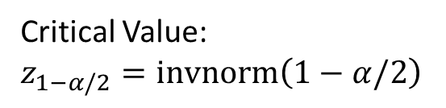
Estimating μ
Critical Value:
$$z_{1−α/2}=invnorm\left(1−α/2\right)$$
$1−\frac{α}{2}$
Point estimate is $\overline{x}$
(1-α)% CI is $(\overline{x}−ME,\overline{x}+ME)$ where $ME$ is decided using
the following decision tree
$$ME=z_{1−α/2} \frac{σ}{\sqrt{n}}$$
Yes
I
Is σ or σ² known?
III
$$ME=t_{(1−\frac{α}{2},n−1)} \frac{S}{\sqrt{n}}$$
No
Yes
II
$$ME=z_{1−α/2} \frac{σ}{\sqrt{n}}$$
Is Population
Distribution
Normal ?
Yes
When Sample Size n ≥ 25
No
Is σ or σ² known?
CI results are not reliable Increase the Sample Size
No

Slide 12
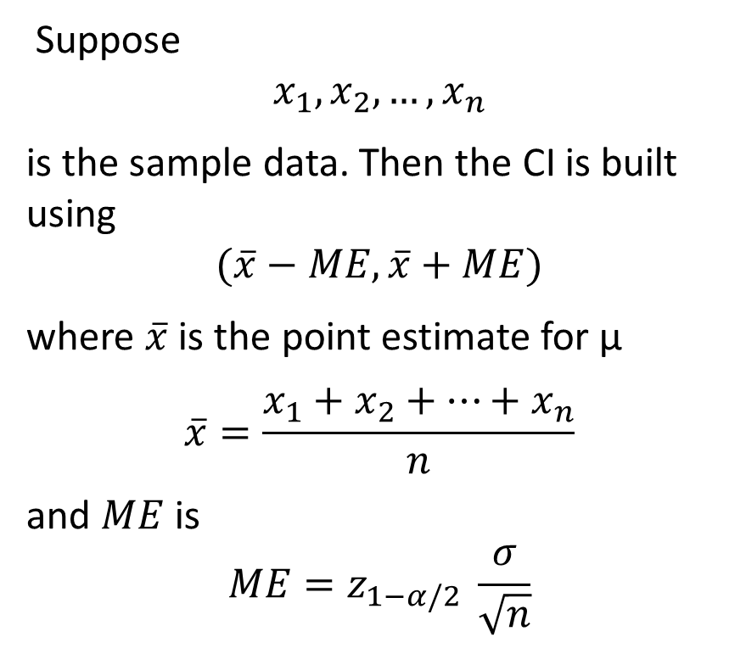
Population type I & II
I
II
Suppose
$$x_{1},x_{2},…,x_{n}$$
is the sample data. Then the CI is built using
$$(\overline{x}−ME,\overline{x}+ME)$$
where $\overline{x}$ is the point estimate for μ
$$\overline{x}=\frac{x_{1}+x_{2}+…+x_{n}}{n}$$
and $ME$ is
$$ME=z_{1−α/2} \frac{σ}{\sqrt{n}}$$
known
known
unknown
unknown
sample of size n
sample of size n≥25
Notes:
We have a random phenomenon which we call X. We are interested in making inference about the general mean “μ” of this random phenomenon. If we know that X has a normal distribution with known variance (type I) OR if we know nothing about distribution of X but its variance is known and sample size is greater than or equal 30 (type II), then we build the (1-α)% CI using $(\overline{x}−ME,\overline{x}+ME)$ where $ME=z_{1−α/2} \frac{σ}{\sqrt{n}}$

Slide 13

Example
You purchased a company that produces phosphate fertilizer and you want to know the mean daily production. WWYD?
You record daily amount of fertilizer produced for 50 days.
The average for 50 days was 850 tons. Suppose you know from historical data that the amount of fertilizer produced daily is normally distributed with standard deviation of 15 tons.
a) State the estimate of the true daily mean produced of fertilizer.
b) Obtain a 95% interval estimate of the true daily mean yield of fertilizer.
c) Interpret the interval.

Slide 14


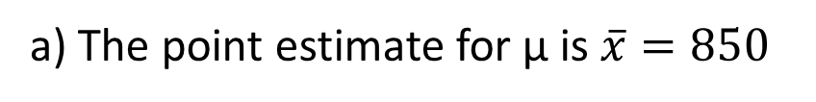

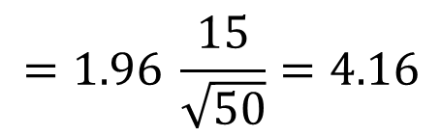


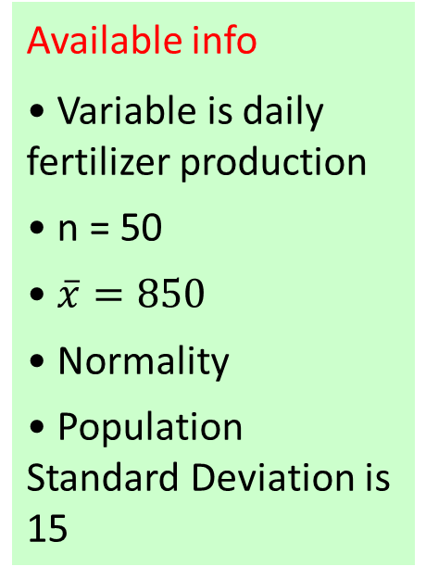


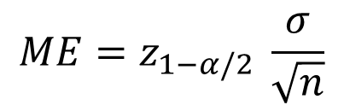


The random phenomenon is X: daily production of fertilizer in tons
We know that X ~ N( μ , σ = 15)
We would like to estimate μ: mean daily production of fertilizer
Available info
• Variable is daily fertilizer production
• n = 50
• $\overline{x}=850$
• Normality
• Population Standard Deviation is 15
a) The point estimate for μ is $\overline{x}=850$
b) The population type is ①, so
$$ME=z_{1−α/2} \frac{σ}{\sqrt{n}}$$
$$=1.96 \frac{15}{\sqrt{50}}=4.16$$
$$1−α=0.95$$
$$⇒ α=0.05$$
$$\left(\overline{x}−ME,\overline{x}+ME\right):$$
$$⇒ α/2=0.025$$
$$\left(850−4.16, 850 +4.16\right):$$
$$⇒1− α/2=0.975$$
$${\left(845.84, 854.16\right)}_{95\%}$$
$$⇒z_{1−α/2}=z_{0.975}$$
c) With 95% confidence, the actual mean daily production of fertilizer is between 845.84 and 854.16 tons
$$=invnorm\left(0.975\right)=1.96$$

Slide 15

Example
The weight of Ruby-throated hummingbirds in a region is normally distributed with standard deviation of σ = 0.24.
A sample of size 16 birds weighted an average of 3.1 oz, build an 80% CI for the average weight of Ruby-throated hummingbirds in the study region.

Slide 16




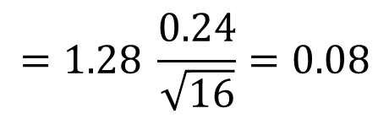


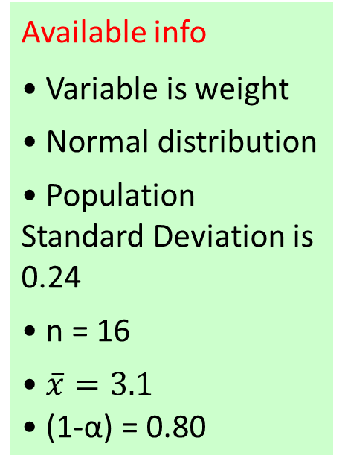




The random phenomenon is X: weight of hummingbirds in grams
We know that X ~ N( μ , σ = 0.24)
We would like to estimate μ: weight of those hummingbirds
Available info
• Variable is weight
• Normal distribution
• Population Standard Deviation is 0.24
• n = 16
• $\overline{x}=3.1$
• (1-α) = 0.80
The point estimate for μ is $\overline{x}=3.1$
The population type is ①, so
$$ME=z_{1−α/2} \frac{σ}{\sqrt{n}}$$
$$=1.28 \frac{0.24}{\sqrt{16}}=0.08$$
$$1−α=0.80$$
$$⇒ α=0.20$$
$$\left(\overline{x}−ME,\overline{x}+ME\right):$$
Using ME: We are 80% confident that the true mean weight is 3.1 with 8% margin of error
$$⇒ α/2=0.10$$
$$\left(3.1−0.08, 3.1 +0.08\right):$$
$$⇒1− α/2=0.90$$
$${\left(3.02, 3.18\right)}_{80\%}$$
$$⇒z_{1−α/2}=z_{0.90}$$
Using CI: With 80% confidence the mean weight of those hummingbirds is between 3.02 and 3.18 oz
$$=invnorm\left(0.90\right)=1.28$$

Slide 17
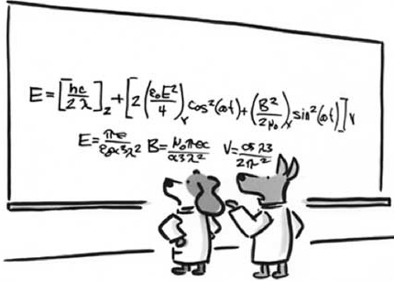
Example
In order to estimate the mean SAT score of US high school students, a random sample of 50 students who have taken SAT in 2004 is selected, one from each of the 50 states, and their score is recorded.
The sample mean of the scores was 537.98. Given the population standard deviation of 34 points.
a) Construct a 90% CI for the true mean SAT score and interpret its meaning.
b) Construct a 99% CI for the true mean SAT score and compare its length with the 90% CI.
c) Construct a 99% CI for the true mean SAT score based on 2 samples from each state and the same sample mean, compare the results with the first CI.

Slide 18


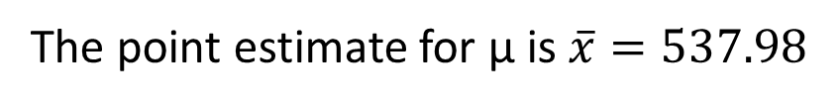

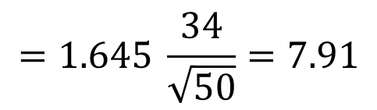


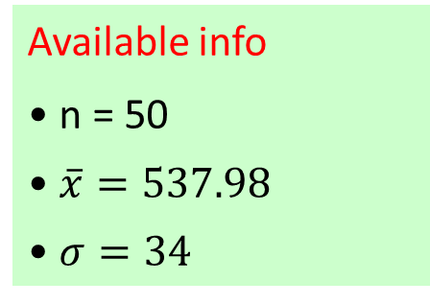




Random phenomenon is X: SAT score of US high school students
We know that X ~ ?( μ , σ = 34)
We would like to estimate μ: mean SAT score
Available info
• n = 50
• $\overline{x}=537.98$
• $σ=34$
The point estimate for μ is $\overline{x}=537.98$
$$ME=z_{1−α/2} \frac{σ}{\sqrt{n}}$$
$$=1.645 \frac{34}{\sqrt{50}}=7.91$$
The population type is ②, so
$$\left(\overline{x}−ME,\overline{x}+ME\right):$$
$$\left(537.98−7.91, 537.98 +7.91\right):$$
$$1−α=0.90$$
$${\left(530.07, 545.89\right)}_{90\%}$$
$$⇒ α=0.10$$
$$⇒ α/2=0.05$$
With 90% confidence the true mean of SAT score in 2004 for all the US is between 530 and 546
$$⇒1− α/2=0.95$$
$$⇒z_{1−α/2}=z_{0.95}$$
90% CI Length = 545.89 – 530.07 = 15.82
$$=invnorm\left(0.95\right)=1.645$$

Slide 19



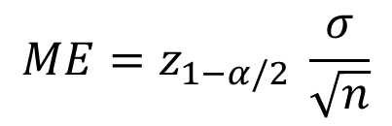






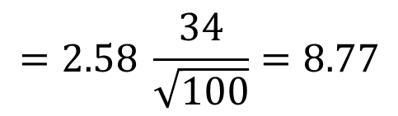
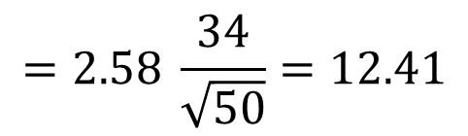


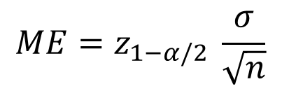
$$ME=z_{1−α/2} \frac{σ}{\sqrt{n}}$$
$$=2.58 \frac{34}{\sqrt{50}}=12.41$$
$$1−α=0.99$$
$$⇒ α=0.01$$
$$\left(\overline{x}−ME,\overline{x}+ME\right):$$
$$\left(537.98−12.41, 537.98 +12.41\right):$$
$$⇒ α/2=0.005$$
$${\left(525.57, 550.36\right)}_{99\%}$$
$$⇒1− α/2=0.995$$
$$⇒z_{1−α/2}=z_{0.995}$$
99% CI Length = 545.36 – 525.57 = 24.81
$$=invnorm\left(0.995\right)=2.58$$
A 99% CI is WIDER than a 90% CI
$$ME=z_{1−α/2} \frac{σ}{\sqrt{n}}$$
$$=2.58 \frac{34}{\sqrt{100}}=8.77$$
$$\left(\overline{x}−ME,\overline{x}+ME\right):$$
$$\left(537.98−8.77, 537.98 +8.77\right):$$
$${\left(529.21, 546.75\right)}_{99\%}$$
Length = 546.75 – 529.21 = 17.54
The new CI that has larger sample size is NARROWER

Slide 20

Example
Assume that the weights of 10-year-old children are normally distributed with a standard deviation of 36 pounds.
Using the weights of six 10-year-old children, what is a confidence interval for the population mean at a 95% confidence level?
70.5 85.6 68.9 102.5 89.0 87.5
Using the calculator:
Input data in List 1
Go to STAT > TESTS > Z-Interval (since pop. type is 1)
Select Data, Enter σ=5, List L1, Freq 1, C-Level 0.95
Press CALCULATE
Write down your answer then use your calculator function to check the final answer
Notes:
ME= 1.96*36/sqrt(6)= 28.81
(84-28.81, 84+28.81)=(55.19, 112.81)

Slide 21

Example
The total waiting time to see a Dr. in a given hospital is known to have a normal distribution with standard deviation 5mins. However, the mean waiting time μ is unknown.
We asked 9 people about how long they have waited before seeing a Dr. and collected the following data (in mins).
Estimate the mean waiting time and construct its 95% CI?
12 8.5 25 17 16 18 16 16.5 21
(Sum = 150)
Write down your answer then use your calculator function to check the final answer
Notes:
ME= 16.67
CI: (13.40, 19.94)

Slide 22

Practice Problems Part 1
1. Suppose that a recent article stated that time spent in jail by first–time convicted burglars follow a bell-shaped distribution with a standard deviation of 1.5 years.
A study was then done to see if the mean time has increased in the new century. A random sample of 26 first–time convicted burglars in a recent year was picked. The average length of time in jail from the survey was 3 years.
Based on this information compute a 98% confidence interval for the true time spent in jail by first time convicted burglars.
Notes:
Answers are provided in Ch6 Practice Problem Solutions

Slide 23

Practice Problems Part 1
2. A study conducted by an airline showed that a random sample of nine of its passengers disembarking at the Winnipeg airport, took an average of 24.1 minutes to claim their luggage.
From a previous survey it was determined that time to claim luggage is normally distributed with a variance of 18 (min²).
Compute a 95% confidence interval for the mean time to claim one’s luggage.
Notes:
Answers are provided in Ch6 Practice Problem Solutions

Slide 24

Practice Problems Part 1
3. A horticulturist wishes to estimate the mean growth of seedlings in a large timber plot. A random sample of n = 100 seedlings is selected and the one-year growth for each is measured.
The sample results in a mean of 5.62 cm. Assuming a standard deviation of 2.50 cm for the one-year growth of seedlings, compute the 95% confidence interval for the mean growth.
Notes:
Answers are provided in Ch6 Practice Problem Solutions

